Slide 1
18ITT42 - DESIGN AND ANALYSIS OF ALGORITHMS (IV-Semester)
Velalar College of Engineering and Technology
(Autonomous)
Department of CSE
(Accredited by NBA)
Handled By:
Dr.V.Latha Jothi , Professor

Slide 2
UNIT – 1 ALGORITHM ANALYSIS
Introduction : Notion of Algorithm – Fundamentals of Algorithmic problem Solving – Important Problem types.
Fundamentals of the Analysis of Algorithm Efficiency : Analysis Framework – Asymptotic notations and Basic Efficiency Classes - Mathematical Analysis of Recursive and Non-recursive algorithms-Empirical analysis of Algorithms-Algorithm Visualization

Slide 3
ANALYSIS FRAMEWORK

Slide 4
EFFICIENCY
Two kinds of efficiency:
Time efficiency also called time complexity, indicates how fast an algorithm in question runs.
Space efficiency, also called space complexity, refers to the amount of memory units required by the algorithm in addition to the space needed for its input and output.
Basic operation of an algorithm is the operation contributing the most to the total running time.

Slide 5
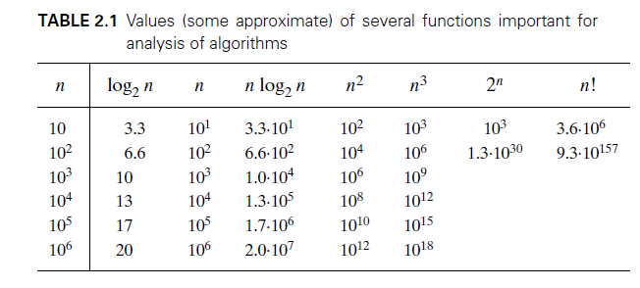
All algorithms run longer on larger inputs

Slide 6
EFFICIENCY (contd.,)
Algorithms that require an exponential number of operations are practical for solving only problems of very small sizes.
An algorithm’s efficiency can be expressed as a function of some parameter n indicating the algorithm’s input size.
Input size differs from problem to problem:
Sorting depends on the number of elements
Addition of numbers depends on no. of digits not how many numbers

Slide 7
Worst-Case, Best-Case, and Average-Case Efficiencies
The worst-case efficiency of an algorithm is its efficiency for the worst-case input of size n, which is an input for which the algorithm runs the longest among all possible inputs of that size.(upper bound of the overall running time)
The best-case efficiency of an algorithm is its efficiency for the best-case input of size n, which is an input for which the algorithm runs the fastest among all possible inputs of that size.

Slide 8
Worst-Case, Best-Case, and Average-Case Efficiencies
The average-case efficiency of an algorithm is the average time taken for all inputs which is difficult to compute.
Worst case efficiency is mathematically easy to compute.

Slide 9
Worst-Case, Best-Case, and Average-Case Efficiencies
ALGORITHM SequentialSearch(A[0..n − 1], K)
//Searches for a given value in an array by sequential search
//Input: An array A[0..n − 1] and a search key K
//Output: The index of the first element in A that matches K
// or −1 if there are no matching elements
i ←0
while i < n and A[i] = K do
i ←i + 1
if i < n return i
else return −1

Slide 10
Worst-Case, Best-Case, and Average-Case Efficiencies
Algorithm’s basic operation is comparison.
C_{best}(n) = 1
C_{worst}(n) = n
C_{avg}(n) = ?
In the case of a successful search, the probability of the first match occurring in the i^{th} position of the list is p/n for every i, and the number of comparisons made by the algorithm in such a situation is obviously i.
In the case of an unsuccessful search, the number of comparisons will be n with the probability of such a search being (1− p).

Slide 11
Worst-Case, Best-Case, and Average-Case Efficiencies
Here when a search is successful, then p=1, so C_{avg}(n) = (n+1)/2, i.e. we have to search to half of the list on an average.
But, when the search is unsuccessful, then p=0, so C_{avg}(n) = n, i.e. we have to search throughout the list.

Slide 12
Amortized Efficiency
Amortized Analysis is used for algorithms where an occasional operation is very slow, but most of the other operations are faster.
In Amortized Analysis, we analyze a sequence of operations and guarantee a worst case average time which is lower than the worst case time of a particular expensive operation.
Eg: Hash Tables, Disjoint Sets and Splay Trees.

Slide 13
THANK YOU

